Slide 1

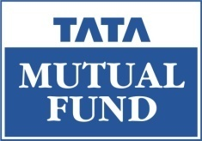
FED TAPERING
UNRAVELING YIELD CURVE

Slide 2

Unraveling the ‘Yield Curve’ - by Prof. Simply Simple

Slide 3

UNRAVELING YIELD CURVE
The yield curve is the relation between the interest rate and the time to maturity of the debt for a given borrower in a given currency.

Slide 4
UNRAVELING YIELD CURVE
So what is ‘yield’?
The yield of a debt instrument is the annualized percentage increase in the value of the investment.
For instance, a bank account that pays an interest rate of 4% per year has a 4% yield.

Slide 5
UNRAVELING YIELD CURVE
So what are the uses of the Yield Curve?
Yield curves are used by fixed income analysts who analyze bonds and related securities to understand conditions in financial markets and seek trading opportunities.
Economists use the curve to understand economic conditions.
The yield curve function Y is actually only known with certainty for a few specific maturity dates. The other maturities are calculated by interpolation.

Slide 6
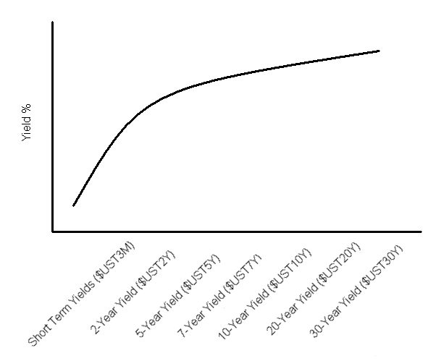
UNRAVELING YIELD CURVE
The typical shape of a Yield Curve

Slide 7
UNRAVELING YIELD CURVE
Now…
Yield curves are usually upward sloping i.e. the longer the maturity, the higher the yield, with diminishing marginal growth (which means that after a point every increase in duration will bring lesser incremental return).

Slide 8
UNRAVELING YIELD CURVE
This is because…
It is easier to predict the near term as against the long term.
Hence, short term papers are usually held by the investor till its maturity.
And long term instruments are usually traded in the market as their returns get affected by changes in interest rates, which occur regularly in an economy.

Slide 9
UNRAVELING YIELD CURVE
Also…
The yield curve can also be flat or even concave in shape where the short term yield is seen to be more than the long term yield.
Yield curves move on a daily basis, reflecting the market's reaction to news.

Slide 10

UNRAVELING YIELD CURVE
Hope you have now understood the concept of Yield Curve

Slide 11

In case of any query, please e-mail professor@tataamc.com

Slide 12

DISCLAIMER
The views expressed in this lesson are for information purposes only and do not construe to be any investment, legal or taxation advice. The lesson is a conceptual representation and may not include several nuances that are associated and vital. The purpose of this lesson is to clarify the basics of the concept so that readers at large can relate and thereby take more interest in the product / concept. In a nutshell, Professor Simply Simple lessons should be seen from the perspective of it being a primer on financial concepts. The contents are topical in nature and held true at the time of creation of the lesson. This is not indicative of future market trends, nor is Tata Asset Management Ltd. attempting to predict the same. Reprinting any part of this material will be at your own risk. Tata Asset Management Ltd. will not be liable for the consequences of such action.
Mutual Fund investments are subject to market risks, read all scheme related documents carefully.

